Slide 1
Vision Transformers:
Bird Species Classification
Sergio Champoux

Slide 2
Introduction
The fundamental objective and significance of this project lie in the development of a sophisticated classification framework tailored to the precise identification of North American bird species.
The task of image classification is pursued through the deployment of a Vision Transformer (ViT) model. The ViT architecture is adept at processing input images in RGB format and generating corresponding textual outputs. Specifically, a foundational transformer model was chosen and subjected to fine-tuning.
By pursuing this trajectory, the aim of this initiative resides in the creation of a classification model, underpinned by an exploration of the cutting-edge resources available within the huggingface platform.

Slide 3
Vision Transformer Overview
A Vision Transformer constitutes a deep learning architecture tailored for image classification tasks, leveraging the transformer paradigm initially conceived for natural language processing (NLP). The inherent self-attention mechanism characteristic of transformers supplies the model with the capacity to capture local and global interdependencies inherent within an image.
Patch Embeddings: An image is divided into fixed-size non-overlapping patches, which are then linearly embedded into a lower-dimensional vector space. These patch embeddings serve as the input to the transformer model.
Positional Encodings: Similar to transformers in NLP, Vision Transformers require positional encodings to provide information about the spatial arrangement of the patches. This helps the model understand the relative positions of different patches in the image.
Transformer Architecture: The core of the ViT consists of multiple transformer layers. Each layer includes self-attention mechanisms that capture relationships between different patches, enabling the model to focus on relevant parts of the image.
Global Context: Unlike traditional CNN’s that mainly capture local features, the self-attention mechanism in ViT allows them to capture long-range dependencies and global context information from the entire image.
Classification Head: The final layer of the ViT is typically a classification head that takes the pooled representations from the transformer layers and maps them to class probabilities.

Slide 4
Dataset
The dataset used for fine-tuning the ViT was sourced from huggingface: gjuggler/bird-data
Training Set: 23,912 images, 405 class labels (species).
Testing Set: 24,615 images, 405 class labels.
This dataset was chosen based on its size and its diversity.
The data contained inconsistent Image resolution across observations.
bird-data consists of the following features:
“Image_file_path” of data type: String.
“Image” of data type: Image.
“labels” of data type: String.

Slide 5
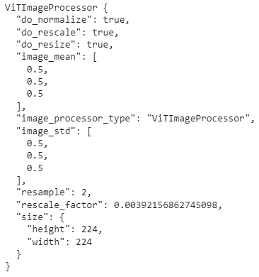
Data Preprocessing
The preprocessing steps performed on the dataset were derived from a module provided by huggingface: image_processor.
Here we display the attributes along with the specified parameters.
This preset was loaded with the model to ensure there were no issues with data format and specifications required for fine-tuning.
Attributes include:
Normalization with specified mean and standard deviation.
Rescaling with specified rescaling factor.
Resizing with specified dimensions.
Resampling input images before feeding into the model.

Slide 6
Fine-tuning Process
The process of fine-tuning the Vision Transformer involved specifying the following:
Collator
Formulated to yield a batch dictionary, from which the model inputs are subsequently extracted and utilized.
Training Arguments
Encompassing elements such as the output directory, batch size, evaluation strategy, epoch count, methodology and frequency of model checkpointing, and the integration of model updates with the repository hub.
Training Function
Entailing the specification of the model architecture requisite arguments, the collator, metric computation strategy, training dataset, as well as the evaluation dataset for testing purposes. Furthermore, the function involves the incorporation of the image_processor to facilitate data preparation.

Slide 7
Fine-tuning Process cont.
Important training arguments that streamlined the fine-tuning process.
output_dir: Defined by the huggingface repository where the model is uploaded.
per_device_train_batch_size: batch size of 16
evaluation_strategy: “steps” Evaluation is done and logged every evaluation step.
num_train_epochs: 1
fp16: True. Whether to use 16 bit precision training instead of 32 bit training.
save_steps: 100. Number of update steps before two checkpoint saves.
eval_steps: 100. Number of update steps between two evaluations.
logging_steps: 10. Number of update steps between two logs.
learning_rate: 2e-4.The initial learning rate for AdamW optimizer.
save_total_limit: 100. Limit the total amount of checkpoints.
remove_unused_columns: False. Ensures we will not remove columns unused by the model forward method.
push_to_hub: True. Push the model to the hub every time it is saved.
report_to: ‘tensorboard’. The list of integrations to which we report the results and logs.
load_best_model_at_end: True. Load the best model found at the end of training in terms of accuracy and loss.

Slide 8
Model Architecture
The base model is sourced from the huggingface repository, specifically Google’s vit-base-patch16-224 model selected for its distinct characteristics.
Notably, this is a visionary transformer base model characterized by a patch size of 16, necessitating input images with a resolution of 224x224 and three channels representing RGB coloration. Preceding its application, the model underwent pre-training on ImageNet-21k followed by fine-tuning on ImageNet 2012. This models origination is credited to the seminal work ‘An Image is Worth 16x16 Words: Transformers for Image Recognition at Scale’ authored by Dosovitskiy et al.
In essence, images are presented to the model in the form of a sequence arrangement of fixed size patches (each of size 16x16) that are subjected to linear embedding.
Through pre-training, the model acquires an internal representation of images facilitating the extraction of features conductive to downstream applications. Notably, a linear layer is situated atop the pre-trained encoder to realize this feature extraction process.

Slide 9
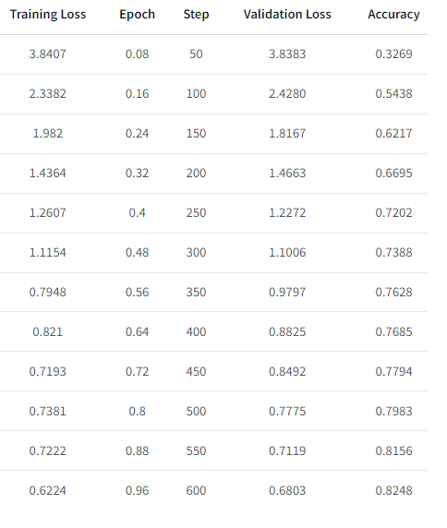
Training Results
The training outcomes are outlined as follow: improvements become increasingly apparent with the progression of steps, as evidenced by decreasing Validation Loss and increasing Accuracy.
The final selection of the “best model” is rooted in the culmination of these steps, reflecting an accuracy rate of 82.48% regarding classifications.
The training process was not devoid of challenges, particularly when applying the complete dataset, prompting a recourse to training and assessing performance on a subset of the training and testing data.
While not attaining an optimal state, the model retains potential for further refinement, with avenues available for continued training aimed at increasing classification accuracy.

Slide 10
Evaluation Metrics
The evaluation metric “accuracy” is sourced from the datasets library.
It serves as a measure of the ratio of accurate predictions to the total instances processed.
Inputs include predictions and test references corresponding to the true label identifiers.
Steps:
The utilization of the np.argmax function within the metric computation framework facilitates the determination of the index associated with the highest value along a designated axis. This transformative process facilitates the conversation of probability scores into corresponding class labels.
Further, the mechanism processes an array of probabilities for distinct classes, enabling their conversion into discrete class labels.
In tandem, the true label identifiers are introduced into the process, fostering the accuracy assessment procedure.

Slide 11
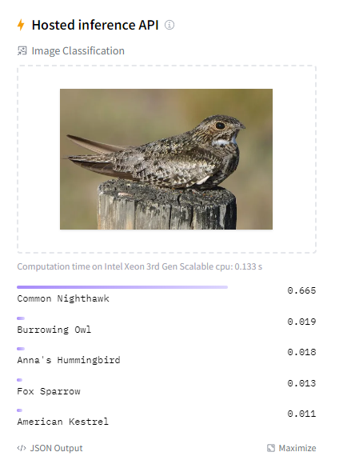
Visualizing Predictions
The illustration depicts an instance of the model’s utilization through the huggingface API.
Following a Google search for “common nighthawk” and subsequent image upload to the API, an accurate performance of the model becomes evident. Notably, the model classified the avian species as a “common nighthawk.”
This exemplar is readily accessible on huggingface’s platform, giving interested individuals the opportunity to engage with the model firsthand.

Slide 12
Acknowledgements
Huggingface is an indispensable resource for this Vision Transformer project, offering pre-trained models, a user-friendly API, fine-tuning capabilities, a supportive community, and efficient tools that enable the successful development and deployment of advanced image classification models as well as models tailored to different tasks.
I strongly recommend utilizing their “transformer” library, as it will not only accelerate your development process but also ensure that you leverage the latest advancements in the field to achieve outstanding results.

Slide 13
Links
My model
An Image is Worth 16x16 Words: Transformers for Image Recognition at Scale
Google’s vit-base-patch16-224

